Slide 1


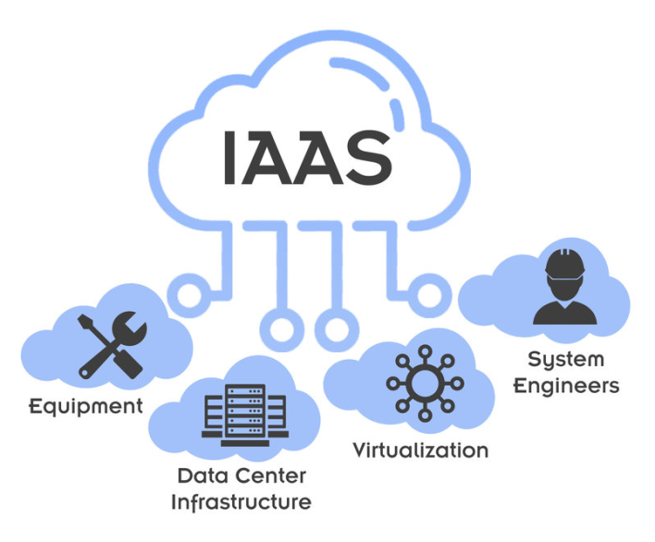
VMware
https://bit.ly/3jJ0nRY

